Slide 1

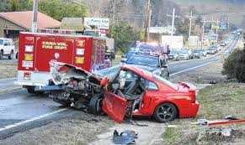
Safe Routes Random Forest Regressor Flowchart
Dataset: Non-accident data (Sampled), obtained via random altering of accident data iterances features. Accident and Non accident data sets are mutually exclusive
Features: Longitude, latitude, day. Month, year , day_week, hour, func_sys, reljct1, weather, route, TWAY_ID, TWAY_ID2
Target: Accidents (Negative/ target =0 )
Dataset
(Accident Table)
Features: Longitude, latitude, day. Month, year , day_week, hour, func_sys, reljct1, weather, route, TWAY_ID, TWAY_ID2
Target: Accidents (Positive/ target = 1)
Random Forest Classifier Pipeline:
Missing Values, Scaling, Encoding
Random Forest Regressor
Likelihood of accident [0- 1]
Balanced Data Set:
⅙ accident data set + ⅚ Non accident data set

Slide 2
Performances
baseline MSE score: 0.139
trainval data MSE score: 0.114
test data MSE score: 0.113

